Slide 1
OpenBCI System
[Usage Instructions]

Slide 2
Available Components
Cyton board [8 channels]
Daisy board [provides additional 8 channels to the Cyton board]
OpenBCI USB Bluetooth Dongle [EEG streaming over Bluetooth]
OpenBCI EEG Electrode Cap
Header Pin to Electrode Adapter for 8 channels [x2]
Wifi Shield [EEG streaming over Wifi]

Slide 3
Relevant Links
General OpenBCI Documentation Page: https://docs.openbci.com/docs/
Setting up Cyton+Daisy board with 16 channels: Electrode Cap Getting Started Guide
Setting up Cyton board with 8 channels: Cyton Getting Started Guide
OpenBCI GUI: The OpenBCI GUI
Streaming EEG data over Wifi using Wifi Shield: WiFi Shield Getting Started Guide
Electrode Cap Care and Cleaning Guide: OpenBCI Electrode Cap Cleaning Guide
External Triggering for Cyton board: External Trigger on OpenBCI Cyton Board · OpenBCI Documentation

Slide 4
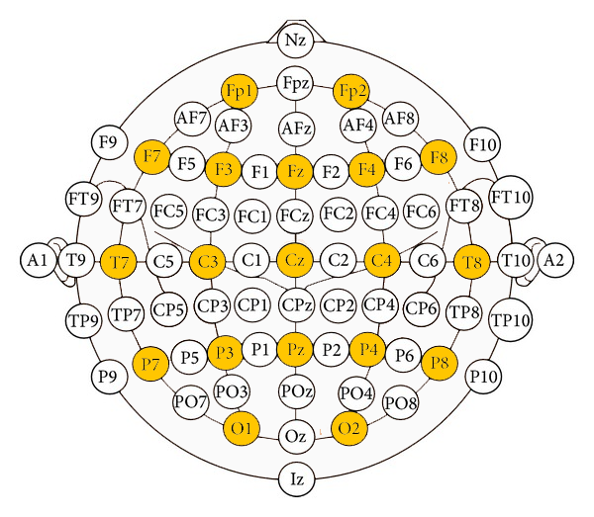
Available Channels
These electrodes map to labels on the electrodes. Please note that the cap uses older labelling, and that T3, T4, T5, and T6 were updated to be T7, T8, P7, and P8, respectively. These placements are interchangeable, and while the labels on the cap use older naming, they correspond to nodes on the diagram.
The available electrode channels are colored in Yellow.

Slide 5
Setting up EEG Stream using Cyton Board
Here are the steps required to stream EEG data from the Cyton (or Cyton + Daisy boards) to a Matlab script over Bluetooth.
Note: If OpenBCI system is being used for a real-time streaming purpose, it is recommended to stream over Bluetooth and not over Wifi as the current Wi-Fi shield firmware has issues with latency, and also jitter in sampling rate was observed when streaming over wifi.

Slide 6
Setting up EEG Stream using Cyton Board
Prerequisites:
Windows Powershell
py_lslstreamer.py (provided in documentation files)
Matlab LSL library or liblsl-Matlab (provided in documentation files) Ensure Python 3 is installed along with Numpy, pyOpenBCI and pylsl libraries. You can find the pyOpenBCI and pylsl libraries here: https://pypi.org/project/pyOpenBCI/ https://pypi.org/project/pylsl/
(These libraries have other dependencies, follow installation instructions in the above URLs)

Slide 7
Connect the HPTA cables to the Board
Connect the HPTA cables to the Cyton board.
In sequence (from first colored cable to last), connect the chosen electrode cables of the cap to the HPTA cables of the board.
Ensure the ground and reference electrode cables are connected to the board.
You may set the subject up with the electrode cap and apply electrode gel to the chosen channels now.
Notes:
REF -> Black (SRB) GND -> White (Bias) N1P to N8P -> O1, O2, P7, P3, Pz, P4, P8 (For the BCI project)

Slide 8
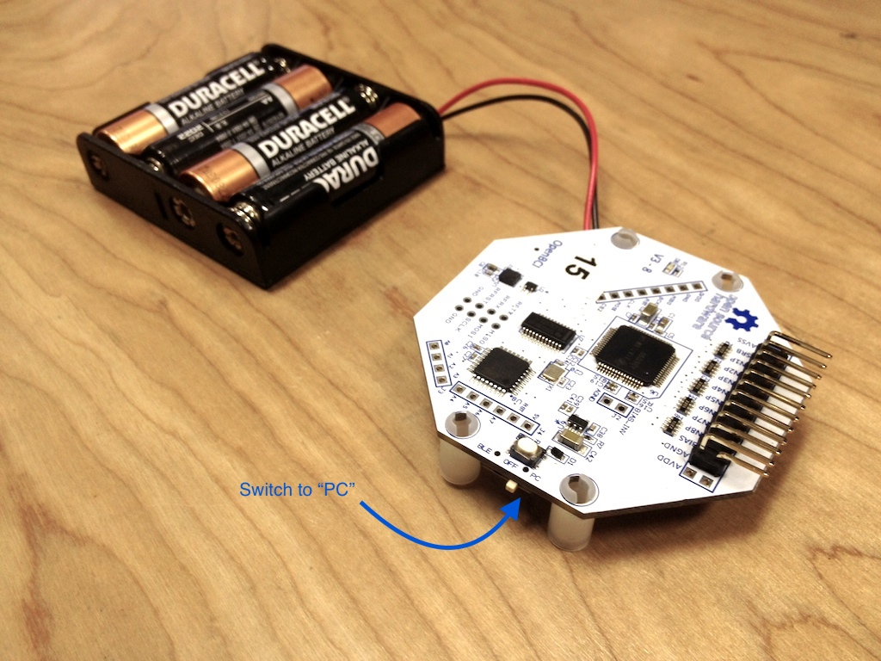
2. Power the Board and Connect the Dongle
Toggle the switch in the USB Dongle to “GPIO 6” (Not Reset).
Plug the USB Dongle to the PC at the COM4 Port (facing upwards!) and you should see a blue LED light up and stay on, as well as a Red LED blink.
Connect the battery pack (4x AA cells) to the board (battery connector is placed on the back of the board).
Toggle the switch on the board which is in OFF mode to PC (Not BLE).

Slide 9
3. Start LSL Stream
Open Windows Powershell and move to the directory where py_lslstreamer.py file is present.
Run the py_lslstreamer.py file
$ python ./py_lslstreamer.py
Let this Powershell instance be running. Now the Python file is reading the data from the COM4 port and streaming it.
Notes:
In Biosemi laptop py_lslstreamer.py is located in C:\Users\Biosemi-Lab\Desktop\Prajwal\python_openBCI

Slide 10
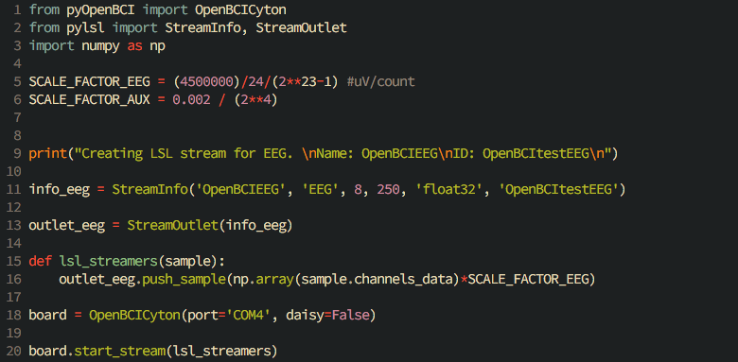
(For reference) Here is the code from the py_lslstreamer.py file

Slide 11
4. Setup Matlab script to receive the EEG data
In a Matlab script, load the liblsl-Matlab and all of its subfolders into the workspace.
The following code is used to receive the EEG data from the LSL stream.

Slide 12
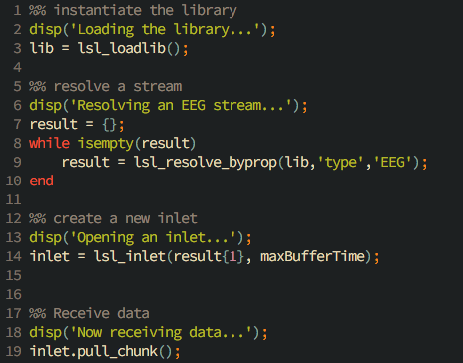
Where maxBuffferTime = 1.0
the inlet buffers samples for `maxBufferTime` seconds before clearing ie `maxBufferTime * Fs` no. of samples

